Slide 1
ML605 MultiBoot Design
May 2010
© Copyright 2010 Xilinx
XTP043

Slide 2
Overview
MultiBoot Capability
Xilinx ML605 Board
Software Requirements
Compile ML605 P30T BPI MultiBoot Design
Program ML605 with P30T BPI MultiBoot Design
Run MultiBoot Design
References
Note: This presentation applies to the ML605

Slide 3
Virtex-6 MultiBoot Capability
Multiple Bitstreams for Multiple Missions
E.g. Power-On self test followed by final application
Hardware assisted system testing
MultiBoot Capability
FPGA Application controlled configuration
Bitstream selection
Safe Update
Golden bitstream
Upgradeable bitstream
Failure recovery
Possible Triggers (CRC error, IDCODE error, WDT timeout)
Note: Presentation applies to the ML605

Slide 4
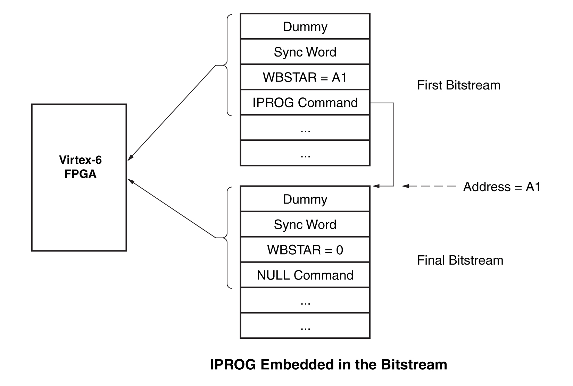
Virtex-6 MultiBoot State Machine Flow Diagram
ICAP Based Designs for Virtex-6 MultiBoot

Slide 5
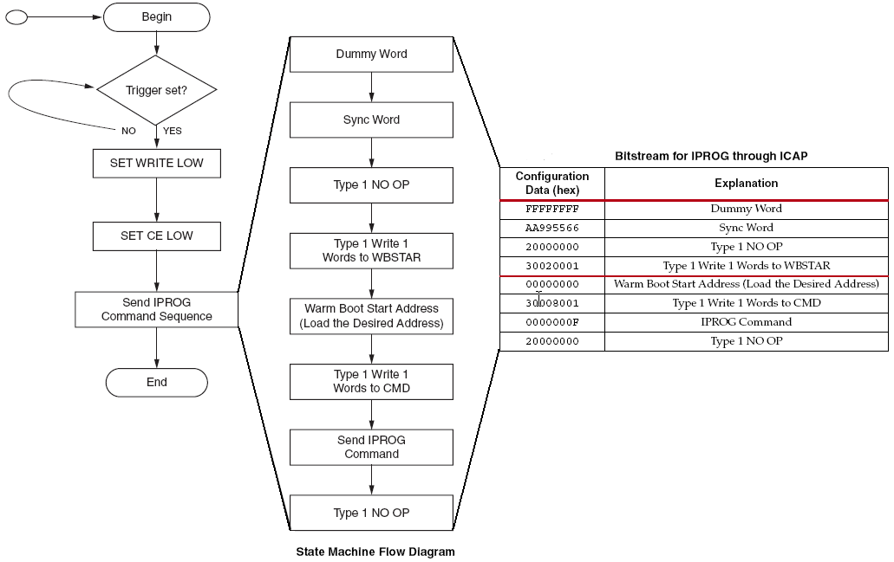
Virtex-6 MultiBoot State Machine Flow Diagram

Slide 6
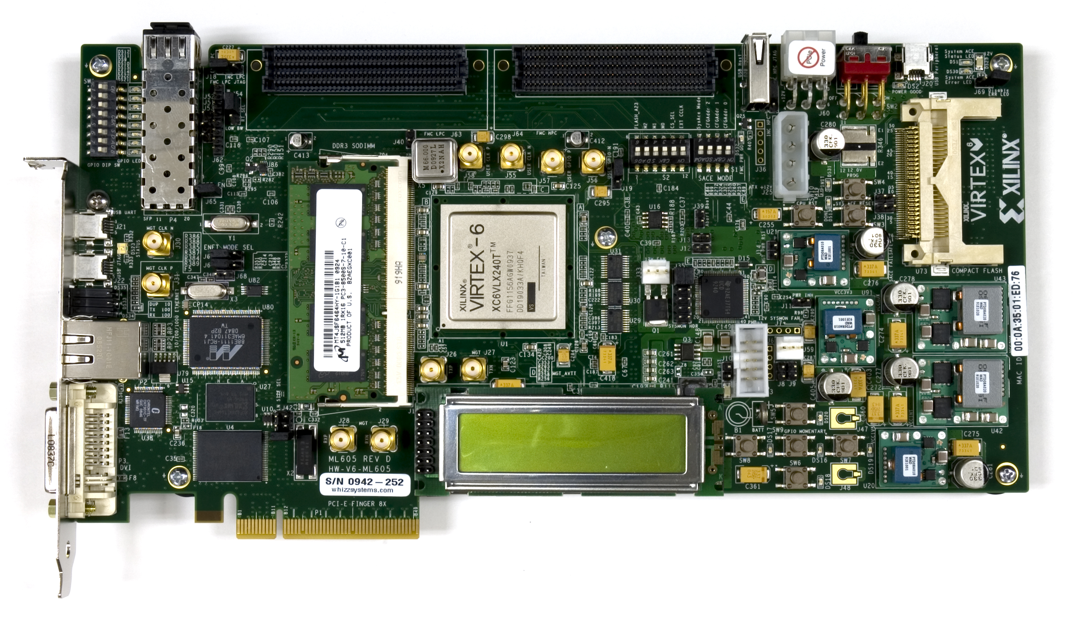
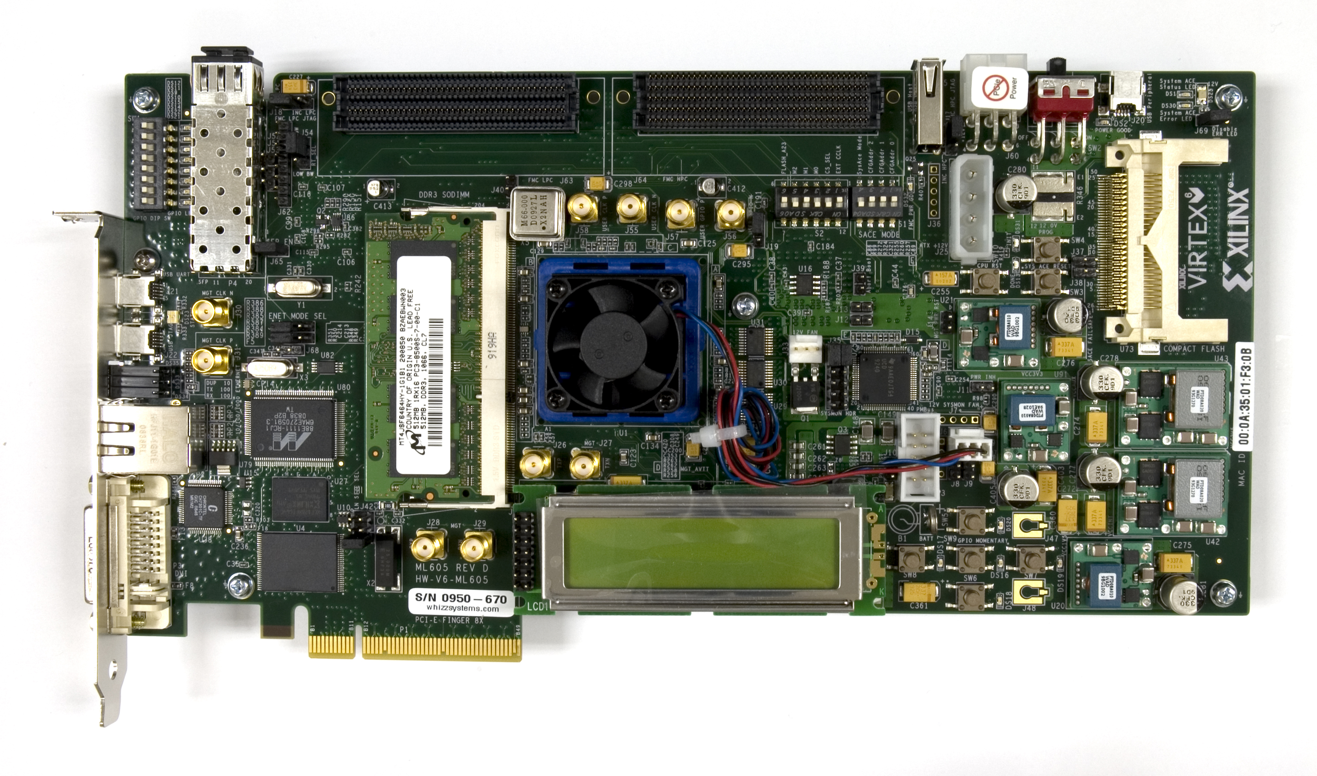
Xilinx ML605 Board
Note: Presentation applies to the ML605

Slide 7
ISE Software Requirements
Xilinx ISE 12.1 software
Note: Presentation applies to the ML605

Slide 8
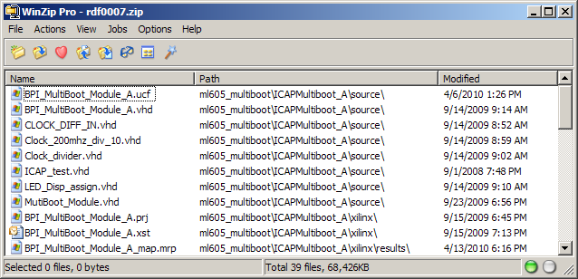
Compile ML605 P30T BPI MultiBoot Design
Unzip the rdf0007.zip file to your C:\ drive
Available through http://www.xilinx.com/ml605
Note: Presentation applies to the ML605

Slide 9
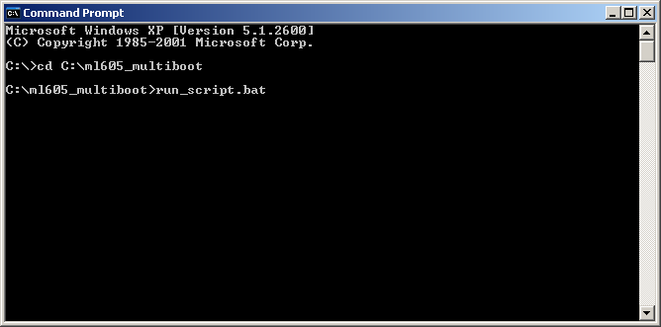
Compile ML605 P30T BPI MultiBoot Design
Compile the BPI Flash:
cd C:\ml605_multiboot
run_script.bat
Note: This step takes about seven minutes

Slide 10
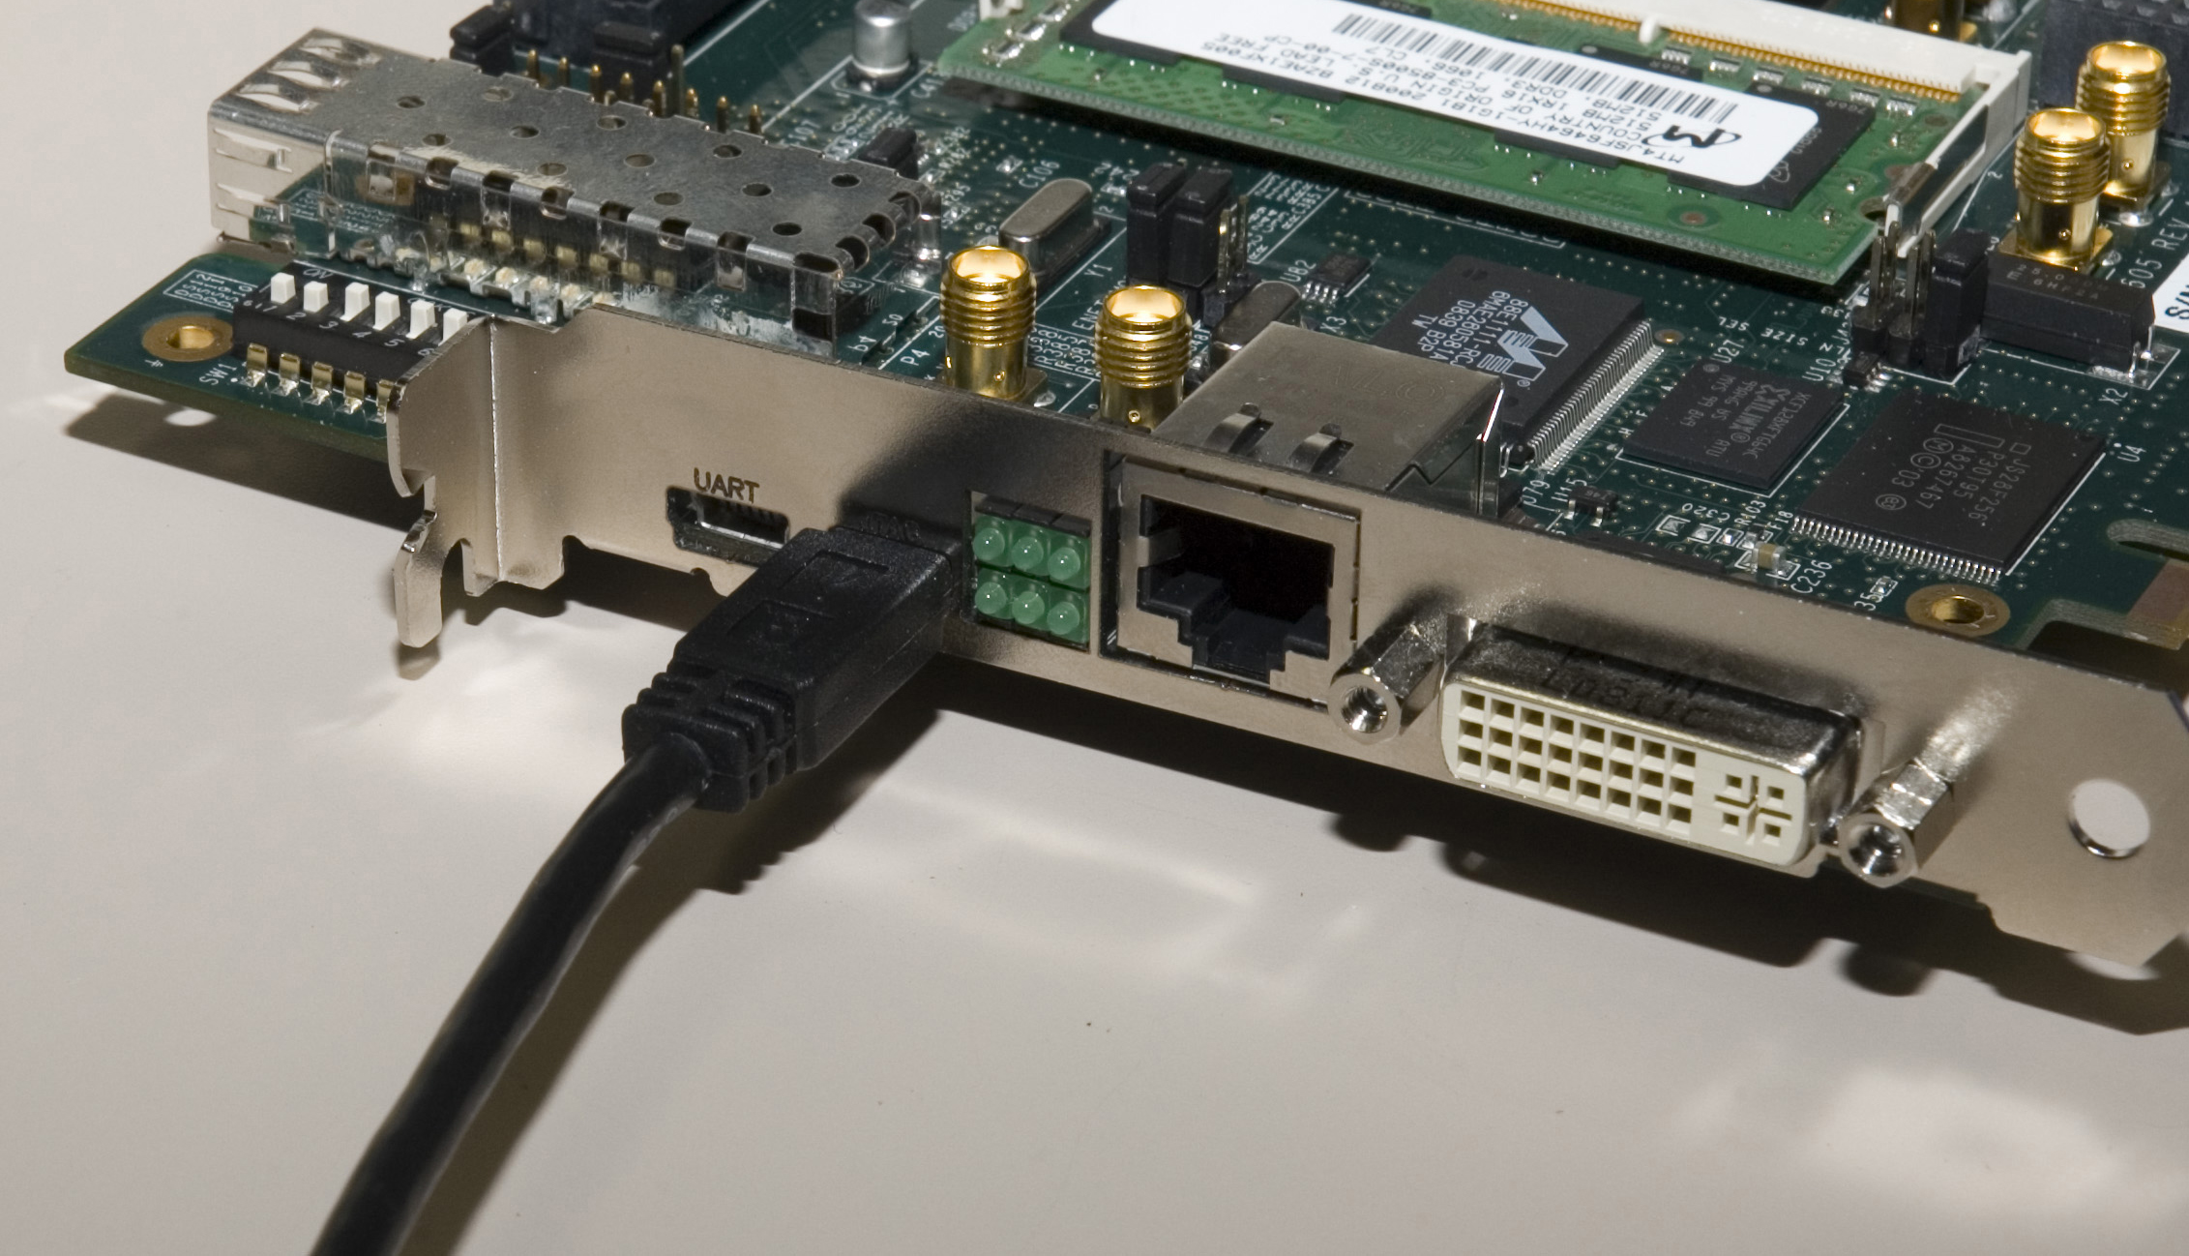
Program ML605 with P30T BPI MultiBoot Design
Power on the ML605 board
Connect a USB Type-A to Mini-B cable to the USB JTAG connector on the ML605 board
Connect this cable to your PC
Note: Presentation applies to the ML605

Slide 11
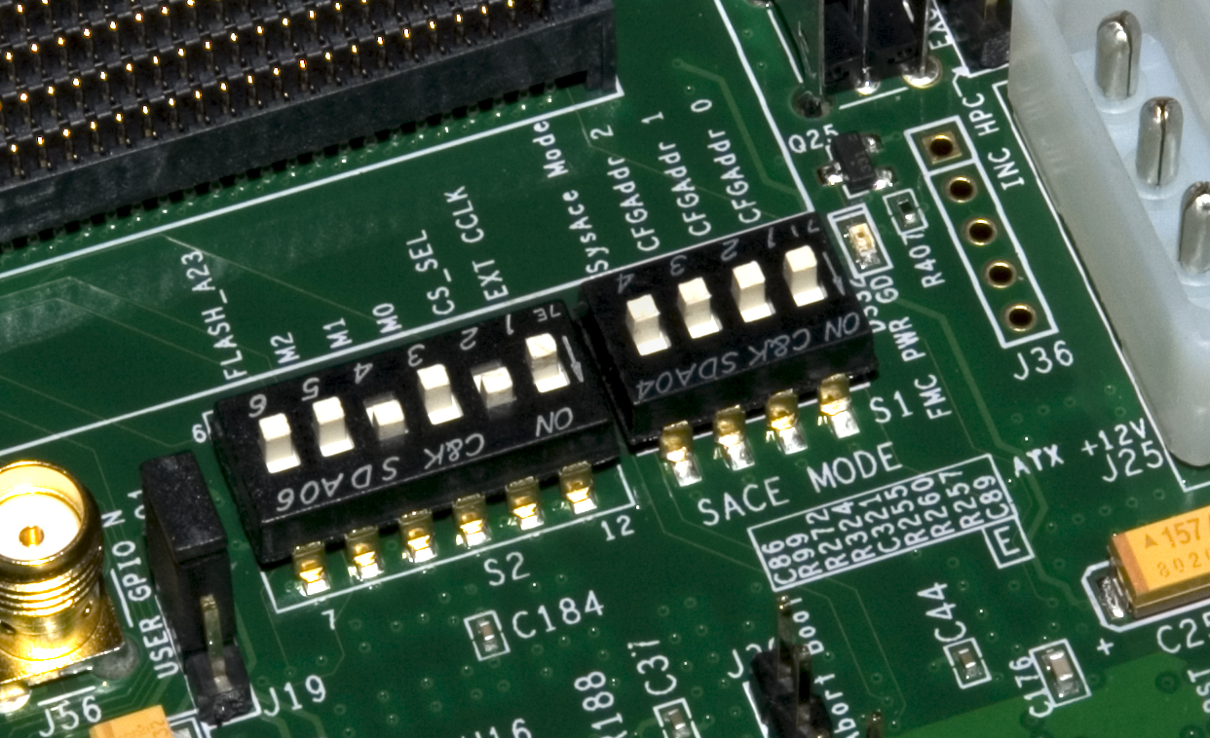
Hardware Setup
Set S2 to 001010 (1 = on, Position 6 → Position 1)
This selects P30T BPI
Mode Switches set to BPI-Up
Set S1 to 0XXX (X = Don’t care, Position 4 → Position 1)
This disables JTAG configuration from the Compact Flash
Note: Presentation applies to the ML605

Slide 12
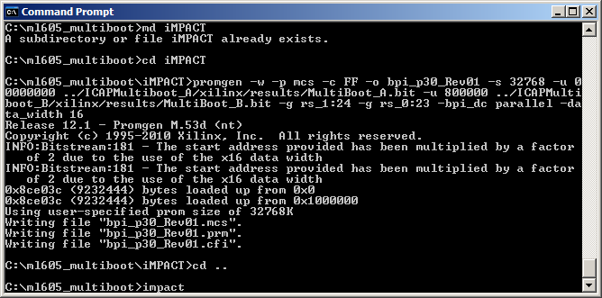
Program ML605 with P30T BPI MultiBoot Design
Run iMPACT
impact
Note: Presentation applies to the ML605

Slide 13
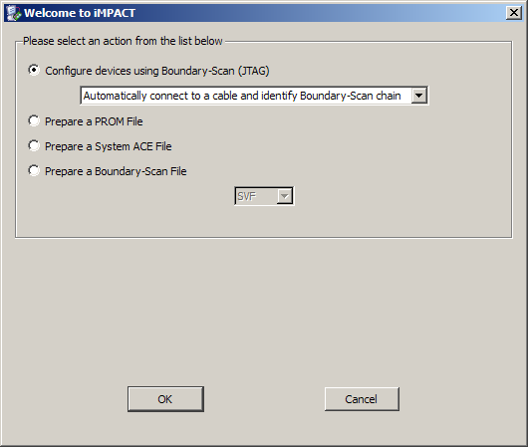
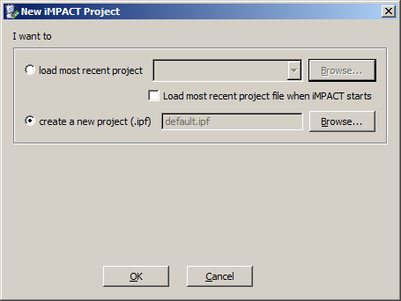
Program ML605 with P30T BPI MultiBoot Design
Select:
Create a new project
Configure devices using Boundary Scan (JTAG)
Note: Presentation applies to the ML605

Slide 14
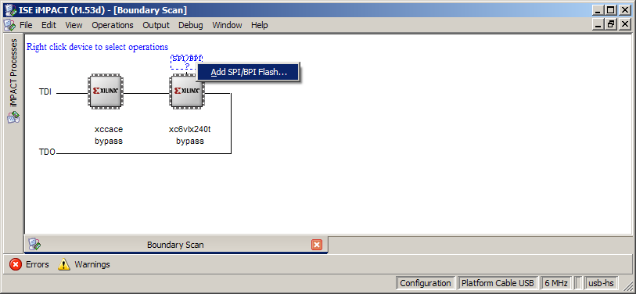
Program ML605 with P30T BPI MultiBoot Design
Right-click on SPI/BPI and select Add SPI/BPI Flash…
Select the <Design path>\iMPACT\bpi_p30_Rev01.mcs
Note: Presentation applies to the ML605

Slide 15
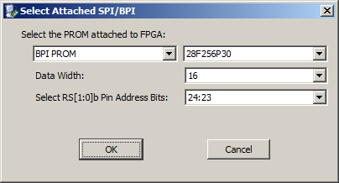
Program SPI MultiBoot Design
In the Select Attached SPI/BPI GUI, select
BPI PROM
28F256P30
Data Width: 16
Address Bits: 24:23
Note: Presentation applies to the ML605

Slide 16
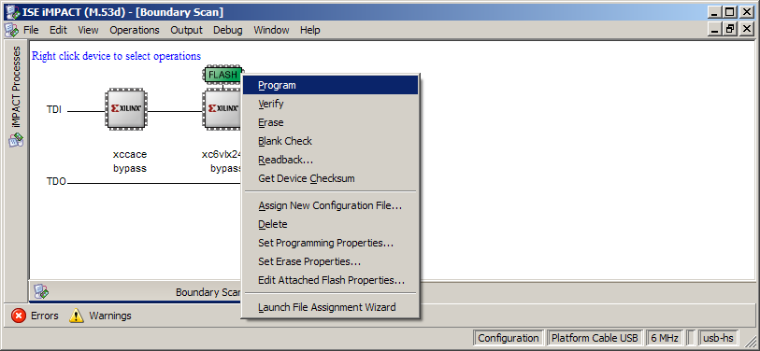
Program ML605 with P30T BPI MultiBoot Design
Program the BPI Flash:
Right-click on the Flash and select Program
Note: Programming takes about 45 minutes with verification

Slide 17
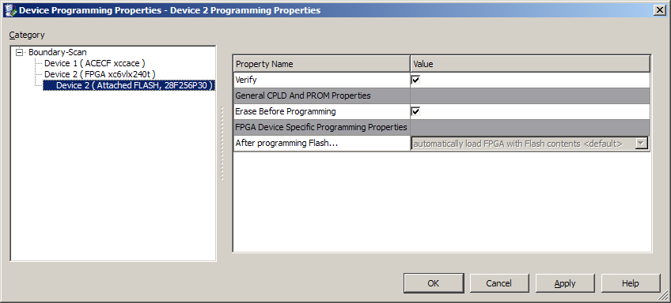
Program SPI MultiBoot Design
Erase Before Programming must be selected
Cycle Board power when programming is complete
Note: Presentation applies to the ML605

Slide 18
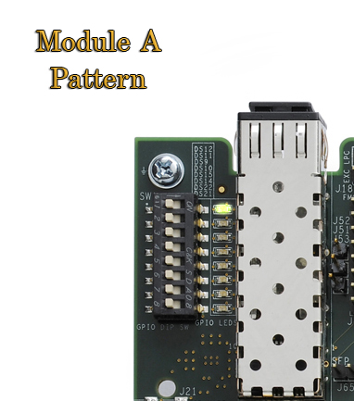
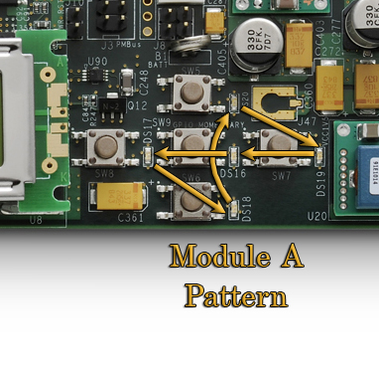
Run MultiBoot Design
The initial LED flashing pattern, Module A will appear
Press SW9 (center button) to go to the next pattern
The DONE led (DS13) will go out momentarily
The ML605 will load the new bitstream from flash and display the next pattern

Slide 19
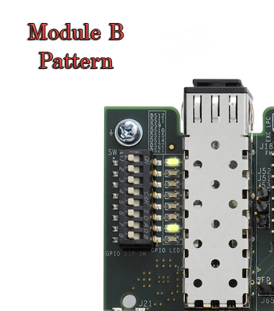
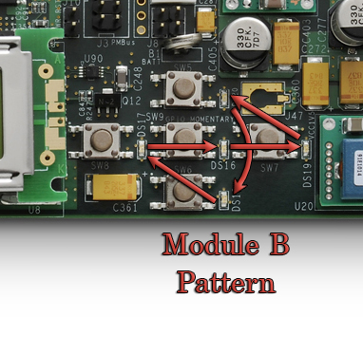
Run MultiBoot Design
The second LED flashing pattern, Module B will appear
Pressing SW9 again will return to the initial pattern

Slide 20
References

Slide 21
References
Virtex-6 Configuration
Virtex-6 FPGA Configuration User Guide
http://www.xilinx.com/support/documentation/user_guides/ug360.pdf

Slide 22
Documentation

Slide 23
Documentation
Virtex-6
Virtex-6 FPGA Family
http://www.xilinx.com/products/virtex6/index.htm
ML605 Documentation
Virtex-6 FPGA ML605 Evaluation Kit
http://www.xilinx.com/products/devkits/EK-V6-ML605-G.htm
ML605 Hardware User Guide
http://www.xilinx.com/support/documentation/boards_and_kits/ug534.pdf
ML605 Reference Design User Guide
http://www.xilinx.com/support/documentation/boards_and_kits/ug535.pdf

